Slide 1




ATMO402 “Applied Atmospheric Dynamics”
Chapter 4 Circulation, Vorticity, and Potential Vorticity A Rotational View of the Atmosphere
$$V$$
L
Coriolis
H
PGF
$$n$$
$$n$$
PGF
Centrifugal
Coriolis
Centrifugal
$$V$$
Cyclonic low
Anti-cyclonic high
GOALS
Diagnosis - Understand dynamics of large scale motion in atmosphere
Circulation, Vorticity and Potential Vorticity
Prognosis - Predict future atmospheric motions
Equations of Circulation, Vorticity and Potential Vorticity
Sen Zhao, Email: zhaos@hawaii.edu

Slide 2
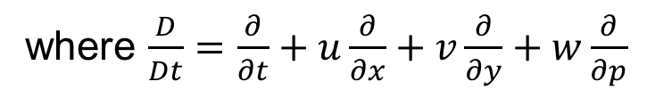
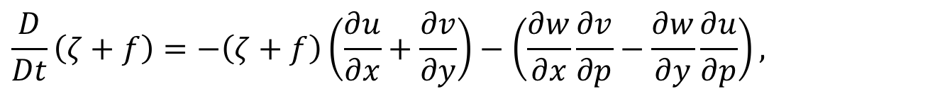
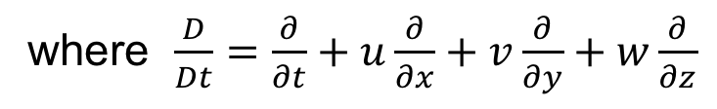
Vorticity equation in different coordinates
Cartesian Coordinate (z)
$$\frac{D}{Dt}\left(ζ+f\right)=−\left(ζ+f\right)\left(\frac{∂u}{∂x}+\frac{∂v}{∂y}\right)−\left(\frac{∂w}{∂x}\frac{∂v}{∂z}−\frac{∂w}{∂y}\frac{∂u}{∂z}\right)−\frac{1}{ρ^{2}}\left(\frac{∂ρ}{∂x}\frac{∂p}{∂y}−\frac{∂ρ}{∂y}\frac{∂p}{∂x}\right),$$
where $\frac{D}{Dt}=\frac{∂}{∂t}+u\frac{∂}{∂x}+v\frac{∂}{∂y}+w\frac{∂}{∂z}$
Change of absolute vorticity may result from
Divergence term
Tilting term
Solenoidal term
Isobaric Coordinates (p)
$$\frac{D}{Dt}\left(ζ+f\right)=−\left(ζ+f\right)\left(\frac{∂u}{∂x}+\frac{∂v}{∂y}\right)−\left(\frac{∂w}{∂x}\frac{∂v}{∂p}−\frac{∂w}{∂y}\frac{∂u}{∂p}\right),$$
where $\frac{D}{Dt}=\frac{∂}{∂t}+u\frac{∂}{∂x}+v\frac{∂}{∂y}+w\frac{∂}{∂p}$
Notes:
Solenoidal term and divergence term

Slide 3
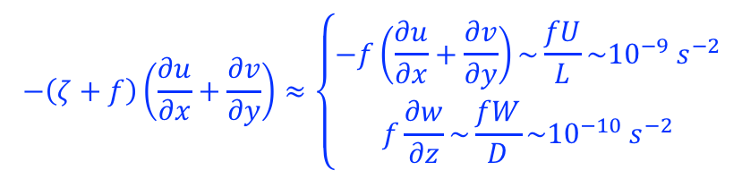
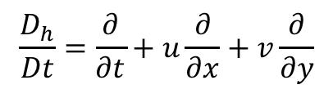
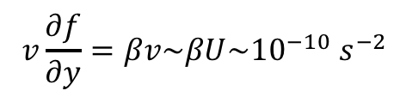
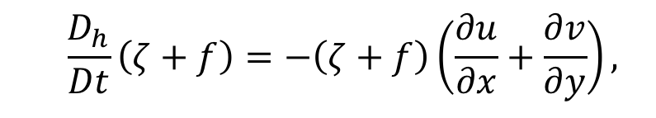
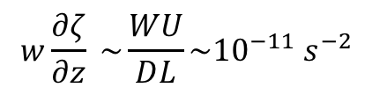
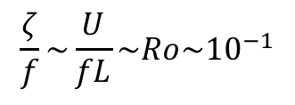
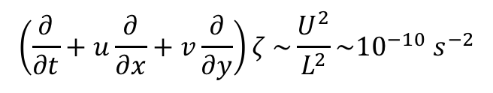

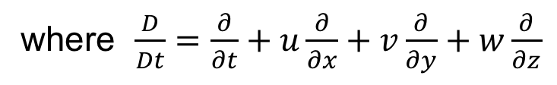
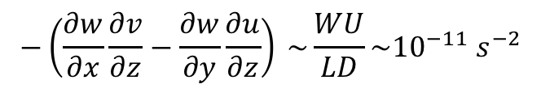
Scale analysis for midlatitude synoptic systems
$$\frac{D}{Dt}\left(ζ+f\right)=−\left(ζ+f\right)\left(\frac{∂u}{∂x}+\frac{∂v}{∂y}\right)−\left(\frac{∂w}{∂x}\frac{∂v}{∂z}−\frac{∂w}{∂y}\frac{∂u}{∂z}\right)−\frac{1}{ρ^{2}}\left(\frac{∂ρ}{∂x}\frac{∂p}{∂y}−\frac{∂ρ}{∂y}\frac{∂p}{∂x}\right),$$
where $\frac{D}{Dt}=\frac{∂}{∂t}+u\frac{∂}{∂x}+v\frac{∂}{∂y}+w\frac{∂}{∂z}$
$$\frac{ζ}{f}\sim \frac{U}{fL}\sim Ro\sim {10}^{−1}$$
$$−\left(ζ+f\right)\left(\frac{∂u}{∂x}+\frac{∂v}{∂y}\right)≈\left\{\begin{aligned}−f\left(\frac{∂u}{∂x}+\frac{∂v}{∂y}\right)\sim \frac{fU}{L}\sim {10}^{−9} s^{−2} \\ f\frac{∂w}{∂z}\sim \frac{fW}{D}\sim {10}^{−10} s^{−2}\end{aligned}\right.$$
$$\left(\frac{∂}{∂t}+u\frac{∂}{∂x}+v\frac{∂}{∂y}\right)ζ \sim \frac{U^{2}}{L^{2}}\sim {10}^{−10} s^{−2}$$
$$−\left(\frac{∂w}{∂x}\frac{∂v}{∂z}−\frac{∂w}{∂y}\frac{∂u}{∂z}\right) \sim \frac{WU}{LD}\sim {10}^{−11} s^{−2}$$
$$w\frac{∂ζ}{∂z} \sim \frac{WU}{DL}\sim {10}^{−11} s^{−2}$$
$$v\frac{∂f}{∂y}=βv\sim βU\sim {10}^{−10} s^{−2}$$
$−\frac{1}{ρ^{2}}\left(\frac{∂ρ}{∂x}\frac{∂p}{∂y}−\frac{∂ρ}{∂y}\frac{∂p}{∂x}\right)\sim \frac{δρδp}{ρ^{2}L^{2}}$ $\sim \frac{{{10}^{−2}∗10}^{3}}{{10}^{12}}\sim {10}^{−11} s^{−2}$
$$\frac{D_{h}}{Dt}\left(ζ+f\right)=−\left(ζ+f\right)\left(\frac{∂u}{∂x}+\frac{∂v}{∂y}\right),$$
$$\frac{D_{h}}{Dt}=\frac{∂}{∂t}+u\frac{∂}{∂x}+v\frac{∂}{∂y}$$
Notes:
I

Slide 4

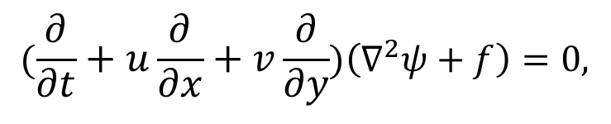
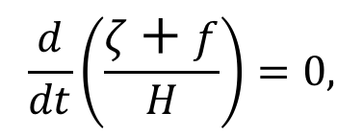
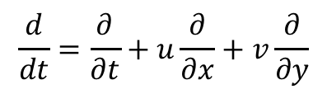
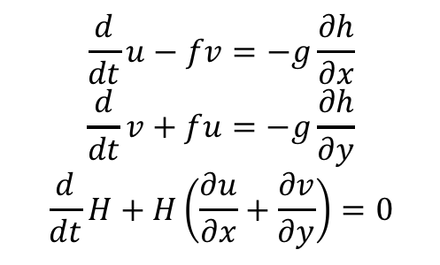
Simplifying vorticity equations even further
Barotropic vorticity equation (barotropic atmosphere with no vertical flow)
$$(\frac{∂}{∂t}+u\frac{∂}{∂x}+v\frac{∂}{∂y})\left(∇^{2}ψ+f\right)=0,$$
$$ζ=∇^{2}ψ$$
One of most important equation in the dynamic meteorology
Rossby waves discussed in future will originated from this equation
Shallow water equations (hydrostatic balance, incompressible)
$$\frac{d}{dt}u−fv=−g\frac{∂h}{∂x}$$
$$\frac{d}{dt}v+fu=−g\frac{∂h}{∂y}$$
$$\frac{d}{dt}H+H\left(\frac{∂u}{∂x}+\frac{∂v}{∂y}\right)=0$$
Rossby Potential Vorticity Conservation Law
$$\frac{d}{dt}\left(\frac{ζ+f}{H}\right)=0,$$
$$\frac{d}{dt}=\frac{∂}{∂t}+u\frac{∂}{∂x}+v\frac{∂}{∂y}$$
Shallow water system is also one of most important equation in atmospheric science.
Many applications

Slide 5
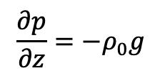
Typos in Holton’s Textbook
Ch4.5, page 115, Eq. (4.31)
Hydrostatic approximation should be
$$\frac{∂p}{∂z}=−ρ_{0}g$$

Slide 6
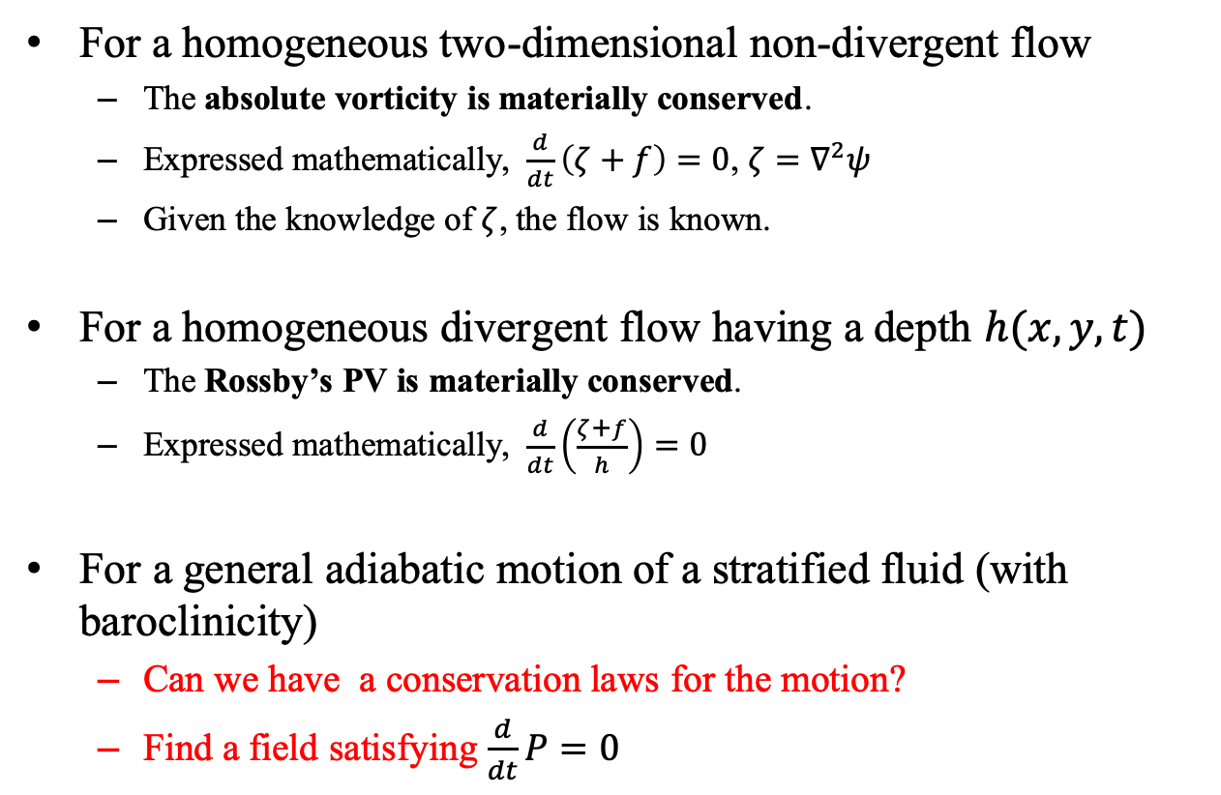
Conservation laws for the motion in free atmosphere
For a homogeneous two-dimensional non-divergent flow
The absolute vorticity is materially conserved.
Expressed mathematically, $\frac{d}{dt}\left(ζ+f\right)=0$, $ζ=∇^{2}ψ$
Given the knowledge of $ζ$, the flow is known.
For a homogeneous divergent flow having a depth $h(x,y,t)$
The Rossby’s PV is materially conserved.
Expressed mathematically, $\frac{d}{dt}\left(\frac{ζ+f}{h}\right)=0$
For a general adiabatic motion of a stratified fluid (with baroclinicity)
Can we have a conservation laws for the motion?
Find a field satisfying $\frac{d}{dt}P=0$
Increasing complexity

Slide 7
Potential Vorticity (PV)

Slide 8
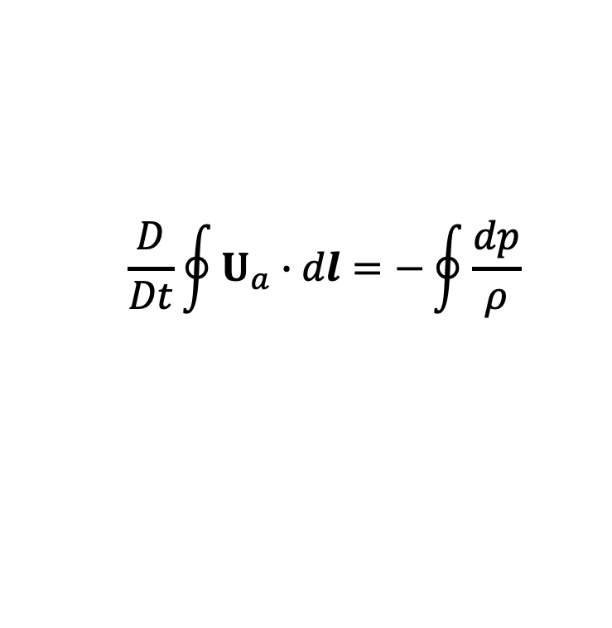
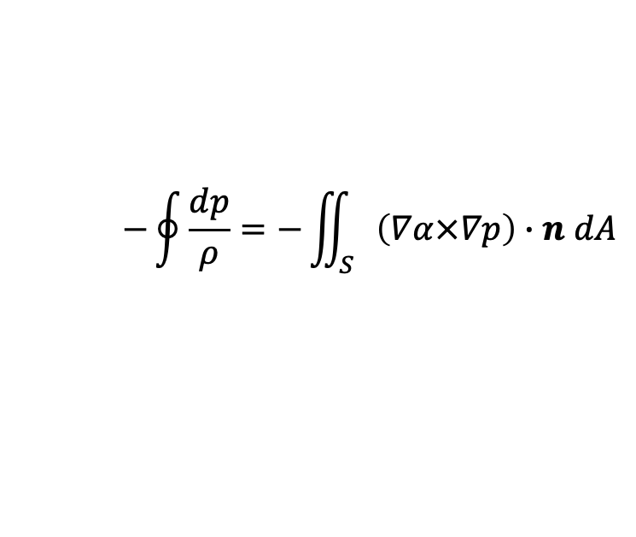
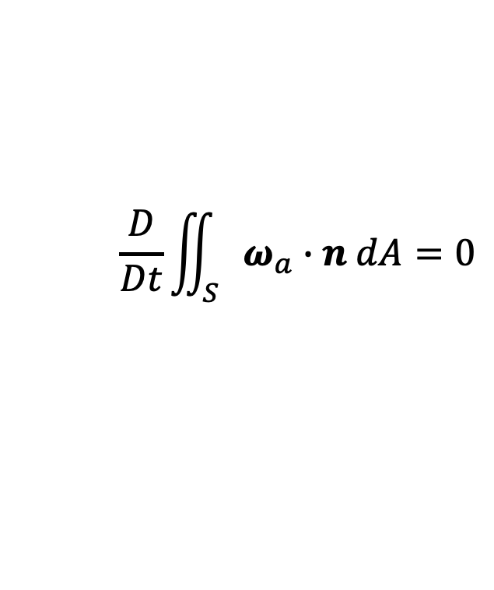
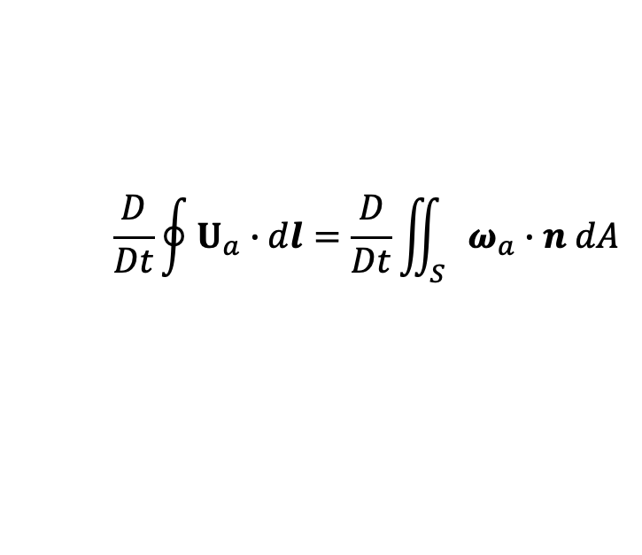
Derivation of PV conservation
Recall the circulation theorem
$$\frac{D}{Dt}\oint{U_{a}∙dl}=−\oint{\frac{dp}{ρ}}$$
using Stokes’s theorem,
$$\frac{D}{Dt}\oint{U_{a}∙dl}=\frac{D}{Dt}\iint_{S}{ω_{a}∙n dA}$$
For a barotropic flow, the solenoidal term vanishes.
$$\frac{D}{Dt}\iint_{S}{ω_{a}∙n dA}=0$$
Kelvin’s circulation theorem in the form of vorticity
Kelvin’s circulation theorem states that the area integral of the normal component of vorticity across any material surface is constant in a barotropic fluid.
$$−\oint{\frac{dp}{ρ}=−\iint_{S}{\left(∇α×∇p\right)∙n dA}}$$
Notes:
we know that for a arbitrary closed contours, we line integral can be converted to the area integral of normal component of vorticity across any material surface.

Slide 9
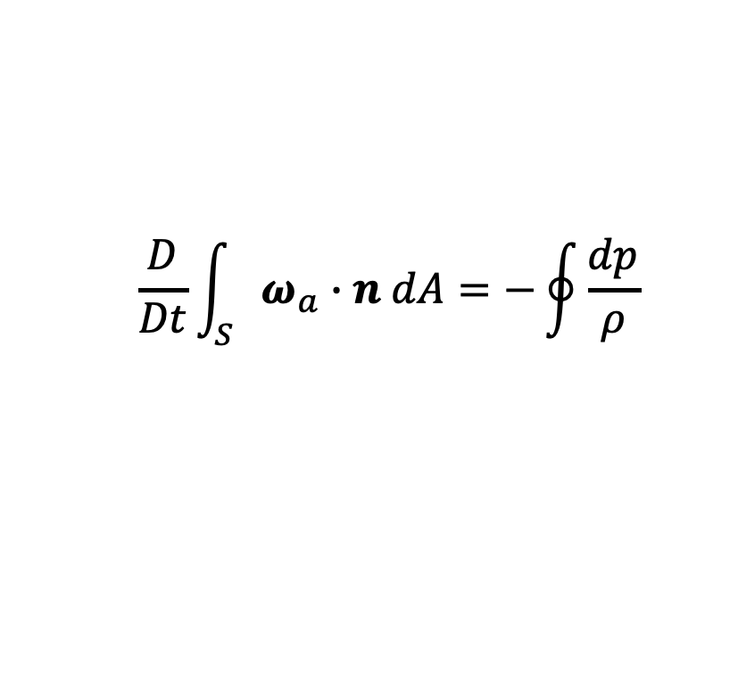
Derivation of PV conservation
Although Kelvin’s circulation theorem is a general statement about vorticity conservation, it is not always a practically useful statement for two reasons
It is not a statement about a field, such as vorticity itself (it is area integral of the normal component of vorticity)
It is not satisfied for baroclinic flow, such as is found in the atmosphere
$$\frac{D}{Dt}\int_{S}{ω_{a}∙n dA}=−\oint{\frac{dp}{ρ}}$$
Rather than arbitrary closed contours, we now restrict the possibilities to those that fall on isentropic surfaces, for which potential temperature is constant

Slide 10
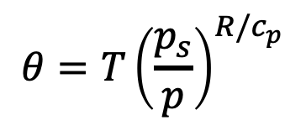
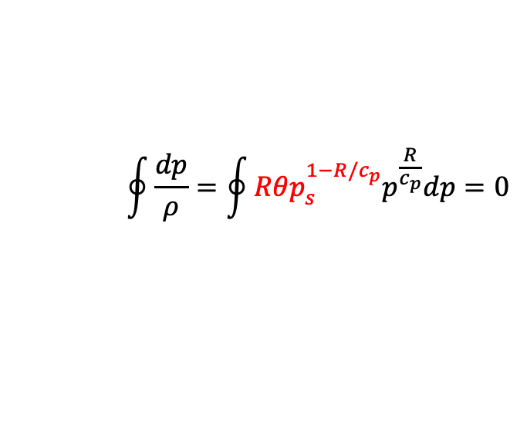
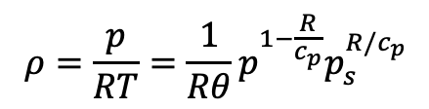
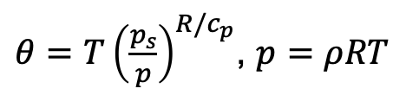
isentropic surface
A surface in space on which potential temperature is everywhere equal.
$$θ=T{\left(\frac{p_{s}}{p}\right)}^{R/c_{p}}$$
Potential temperature is conserved during an adiabatic process.
On isentropic surface, density is is a function of pressure alone, the solenoidal term in the circulation theorem vanishes
Potential temperature increases with height
$θ=T{\left(\frac{p_{s}}{p}\right)}^{R/c_{p}}$, $p=ρRT$
$$\oint{\frac{dp}{ρ}=\oint{Rθp_{s}^{1−R/c_{p}}p^{\frac{R}{c_{p}}}dp=0}}$$
$$ρ=\frac{p}{RT}=\frac{1}{Rθ}p^{1−\frac{R}{c_{p}}}p_{s}^{R/c_{p}}$$

Slide 11
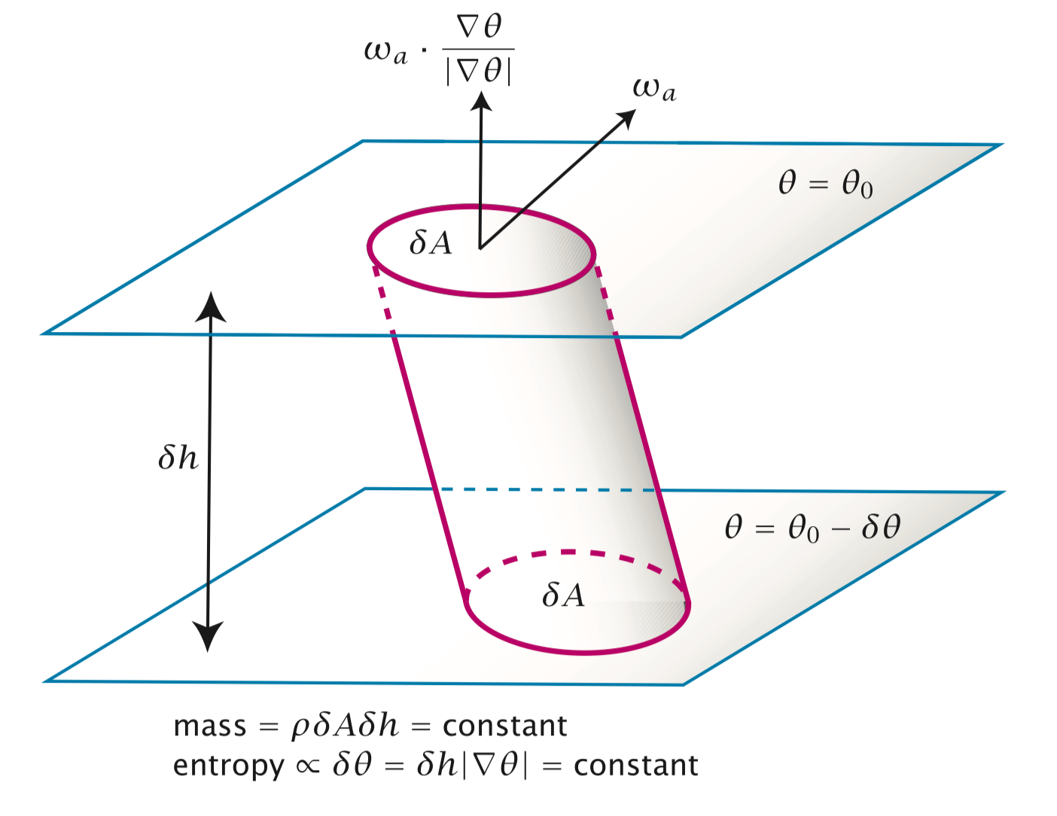
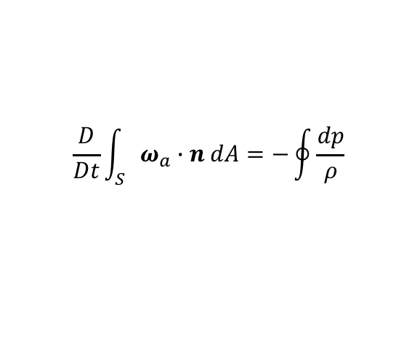
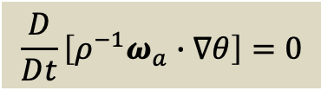
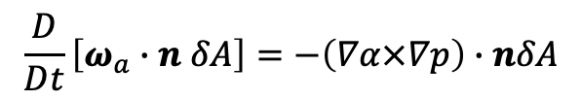
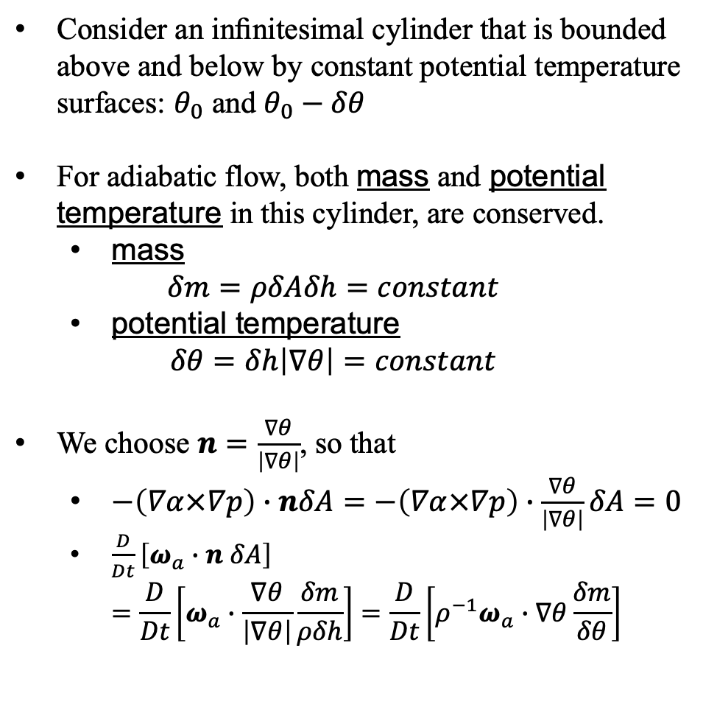
$$\frac{D}{Dt}\int_{S}{ω_{a}∙n dA}=−\oint{\frac{dp}{ρ}}$$
Derivation of PV conservation
$$\frac{D}{Dt}\left[ω_{a}∙n δA\right]=−\left(∇α×∇p\right)∙nδA$$
Consider an inﬁnitesimal cylinder that is bounded above and below by constant potential temperature surfaces: $θ_{0}$ and $θ_{0}−δθ$
For adiabatic flow, both mass and potential temperature in this cylinder, are conserved.
mass $δm=ρδAδh=constant$
potential temperature $δθ=δh\left|∇θ\right|=constant$
We choose $n=\frac{∇θ}{\left|∇θ\right|}$, so that
$−\left(∇α×∇p\right)∙nδA=−\left(∇α×∇p\right)∙\frac{∇θ}{\left|∇θ\right|}δA=0$
$\frac{D}{Dt}\left[ω_{a}∙n δA\right]$ $=\frac{D}{Dt}\left[ω_{a}∙\frac{∇θ}{\left|∇θ\right|}\frac{δm}{ρδh}\right]=\frac{D}{Dt}\left[ρ^{−1}ω_{a}∙∇θ\frac{δm}{δθ}\right]$
$$\frac{D}{Dt}\left[ρ^{−1}ω_{a}∙∇θ\right]=0$$

Slide 12
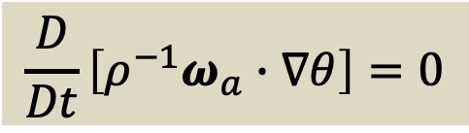
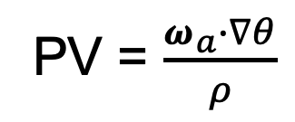
Definition of Potential Vorticity (PV)
Ertel potential vorticity theorem in adiabatic conditions
$$\frac{D}{Dt}\left[ρ^{−1}ω_{a}∙∇θ\right]=0$$
PV = $\frac{ω_{a}∙∇θ}{ρ}$
The beautiful conservation of potential vorticity has profound consequences in fluid dynamics, especially in a rotating, stratified (baroclinic) fluid
It links all of the basic physical conservation laws into a single expression
PV places a powerful constraint on both dynamic and thermodynamic ﬂuctuations

Slide 13
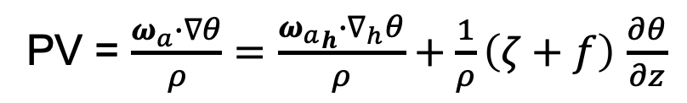
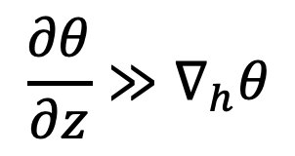


Ertel PV has contribution mainly from vertical component of vorticity
PV = $\frac{ω_{a}∙∇θ}{ρ}=\frac{{ω_{a}}_{h}∙∇_{h}θ}{ρ}+\frac{1}{ρ}\left(ζ+f\right)$ $\frac{∂θ}{∂z}$
horizontal
vertical
$\frac{∂θ}{∂z}≅\frac{310−290}{3.3}\frac{K}{km}$ ~ 6 K/km
$\frac{∂θ}{∂y}≅\frac{310−290}{40−70}\frac{K}{degree}$ ~ 6×10⁻³ K/km
6.3 km
300
310
$$\frac{∂θ}{∂z}≫∇_{h}θ$$
3 km
290
70N
40N
This serves to explain why we focus on the vertical component of vorticity in dynamic meteorology
Notes:
http://www.csgnetwork.com/pressurealtcalc.html

Slide 14
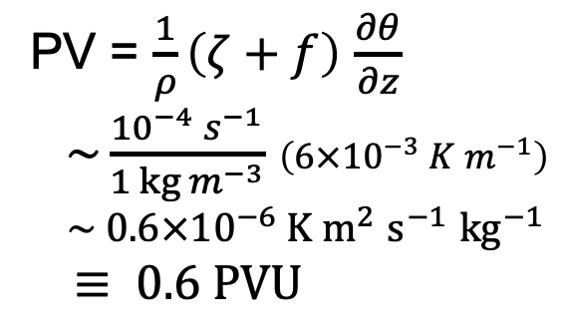
Potential Vorticity (PV) Scales and Units
PV = $\frac{1}{ρ}\left(ζ+f\right)$ $\frac{∂θ}{∂z}$
$\sim \frac{{10}^{−4} s^{−1}}{1 kg m^{−3}}$ $\left({6×10}^{−3} {K m}^{−1}\right)$
$\sim 0.6{×10}^{−6} {K m}^{2}$ $s^{−1}$ ${kg}^{−1}$ $$≡ 0.6 PVU$$
6.3 km
300
310
The deﬁnition “PVU” is a commonly adopted scaling of “PV Units” (1 PVU = 10⁻⁶ K m² s⁻¹ kg⁻¹ ).
3 km
290
70N
40N
In the lower stratosphere, where ∂θ/∂z is an order of magnitude larger, characteristic values of PV are larger as well.
Because there is an abrupt jump in PV values at the troposphere PV provides a useful dynamical deﬁnition for that interface (“dynamical” tropopause, usually 1.5 or 2 PVU).
Since jet streams are located near the tropopause, PV perspective is much more useful than isobaric surfaces, which require several maps to depict jet streams located at different elevations.

Slide 15
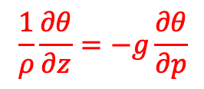
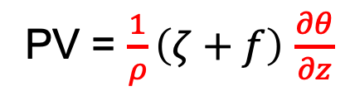
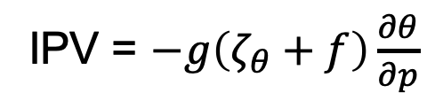
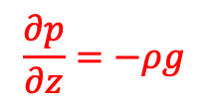
Isentropic Potential Vorticity (IPV)
$$\frac{∂p}{∂z}=−ρg$$
$$\frac{1}{ρ}\frac{∂θ}{∂z}=−g\frac{∂θ}{∂p}$$
PV = $\frac{1}{ρ}\left(ζ+f\right)$ $\frac{∂θ}{∂z}$
IPV = $−g\left(ζ_{θ}+f\right)\frac{∂θ}{∂p}$

Slide 16
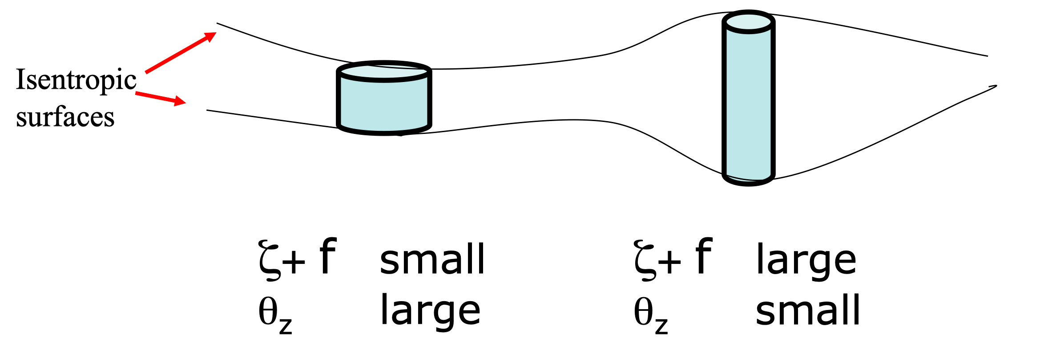

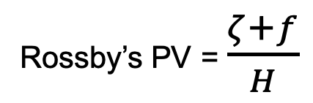
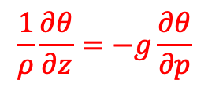
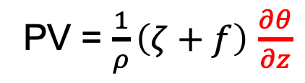


What’s the meaning of PV conservation? Ertel’s PV VS. Rossby’s PV
PV = $\frac{1}{ρ}\left(ζ+f\right)$ $\frac{∂θ}{∂z}$
Rossby’s PV = $\frac{ζ+f}{H}$
lapse rate of potential temperature
relative vorticity
planetary vorticity (latitude dependent)
$$θ+δθ$$
$$θ$$
$$\frac{1}{ρ}\frac{∂θ}{∂z}=−g\frac{∂θ}{∂p}$$
“effective depth”: $\frac{∂θ}{∂p}$
Compensation between ζ increase and θ_{z} decrease

Slide 17
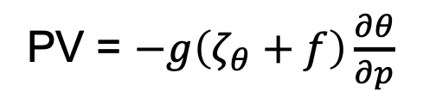
Implications of PV conservation
PV = $−g\left(ζ_{θ}+f\right)\frac{∂θ}{∂p}$
Convergence/Divergence → Change relative vorticity (keeping latitude fixed) → Change stability

Slide 18
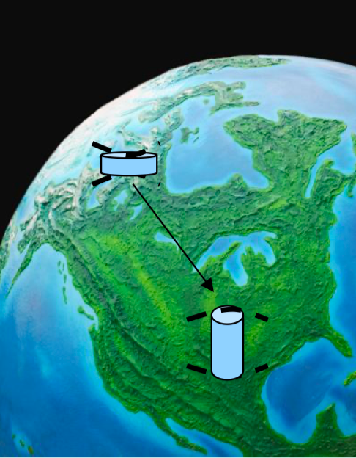
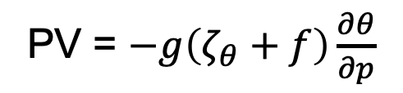
Implications of PV conservation
PV = $−g\left(ζ_{θ}+f\right)\frac{∂θ}{∂p}$
Under constant stability, parcels moving south (north) will increase (decrease) in relative vorticity.
Under constant relative vorticity, parcels moving south (north) will increase (decrease) in stability.

Slide 19
Implications of PV conservation

Slide 20
Potential vorticity (PV) in isentropic coordinates

Slide 21

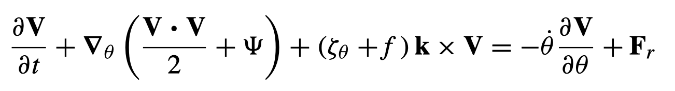
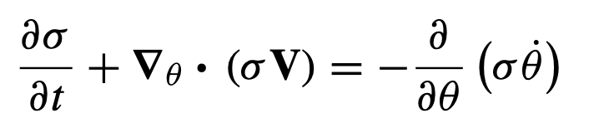



Equations in Isentropic Coordinates
If the atmosphere is stably stratiﬁed so that potential temperature θ is a monotonically increasing function of height, θ may be used as an independent vertical coordinate.
Vertical “velocity” : $\dot{θ}=\frac{Dθ}{Dt}$
“density”:
Momentum equation
Continuity equation
isentropic relative vorticity
Hydrostatic equation
Montgomery streamfunction

Slide 22


Isentropic PV equation
is the Ertel potential vorticity.
If the diabatic and frictional terms on the right side can be evaluated, it is possible to determine the evolution of IPV following the horizontal motion on an isentropic surface.
When the diabatic and frictional terms are small, potential vorticity is approximately conserved following the motion on isentropic surfaces.

Slide 23
Thank You
Prof. Fei-Fei Jin will be back in next week!!!

