Slide 1
Chapter 3
Elementary Applications of the Basic Equations
Pressure as a Vertical Coordinate
Basic Equations in Isobaric Coordinates
The Momentum Equation
The Continuity Equation
The Thermodynamic Energy Equation
Natural Coordinates
Balanced Flow
Geostrophic Flow
Inertial Flow
Cyclostrophic Flow
The Gradient Wind Approximation
The Thermal Wind
Han-Ching Chen & Sen Zhao

Slide 2
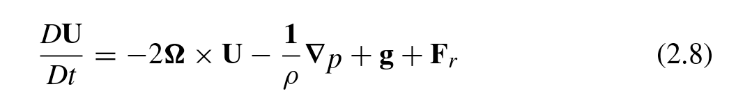
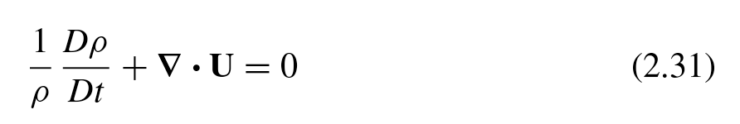
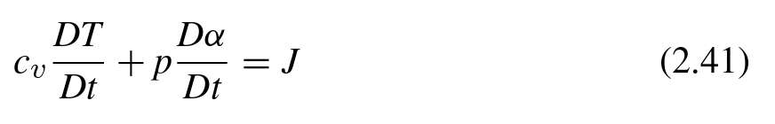

Equations based on physical Laws
Momentum Equation
Continuity Equation
Thermodynamics Equation
Gas Equation
$$P=ρRT$$
(u, v, w, p, T )

Slide 3
Questions
How do we solve these equations?
What kind of methods (tools) do you expect to use to simplify the equations?
Scale analysis for different weather systems
Reasonable assumptions
Useful coordinates for better depicting specific situations
More variables (vorticity, divergence, potential vorticity ……)
Linearization for wave theory
Parameterization for subsystems

Slide 4
Vertical Coordinate
A monotonic function of height or pressure
Height
Pressure
Potential temperature
Sigma
…
Can be used as the independent vertical coordinate

Slide 5

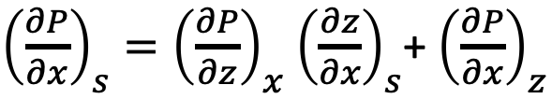

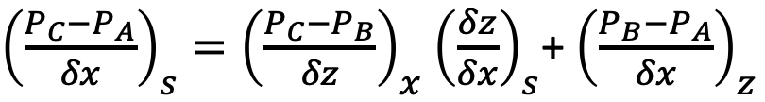
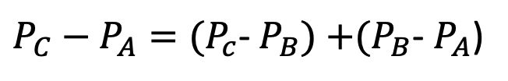
Conversion of Vertical Coordinates
$P_{C}−P_{A}=(P_{c}$- $P_{B})$ $+(P_{B}$- $P_{A}$)
${\left(\frac{P_{C}−P_{A}}{δx}\right)}_{s}={\left(\frac{P_{C}−P_{B}}{δz}\right)}_{x}$ ${\left(\frac{δz}{δx}\right)}_{s}$+ ${\left(\frac{P_{B}−P_{A}}{δx}\right)}_{z}$
Taking the limits as $δx,δz→0$
${\left(\frac{∂P}{∂x}\right)}_{s}={\left(\frac{∂P}{∂z}\right)}_{x}$ ${\left(\frac{∂z}{∂x}\right)}_{s}$+ ${\left(\frac{∂P}{∂x}\right)}_{z}$
EX：pressure or $θ$

Slide 6

Pressure as a Vertical Coordinate
Why do we use pressure coordinates?
Weather maps use pressure surfaces instead of height surfaces.
It is most convenient to use pressure vertical coordinate in the topics.
(why? $ρ=ρ(p)$, or isothermal)
We rewrite the dynamic equations in isobaric coordinates

Slide 7
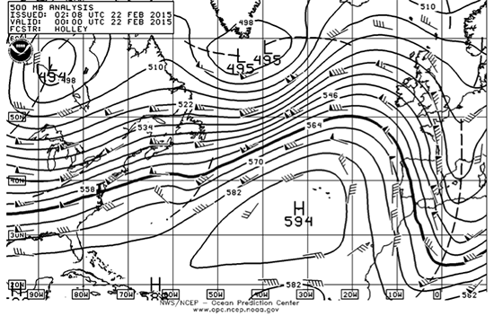
500 mb winds for 22 February 2015. Numbers are altitude in tens of meters (i.e., the 500 mb surface in the high is at 5940 m (594 dm) altitude). Credit: NOAA

Slide 8
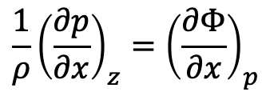
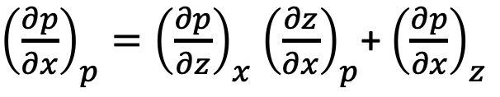
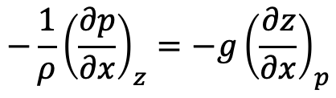
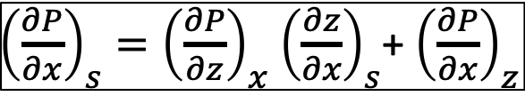
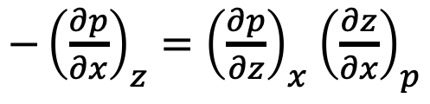
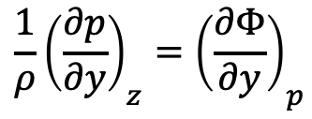
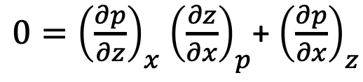
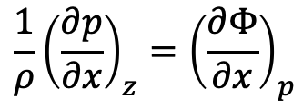

P-Coordinate
${\left(\frac{∂P}{∂x}\right)}_{s}={\left(\frac{∂P}{∂z}\right)}_{x}$ ${\left(\frac{∂z}{∂x}\right)}_{s}$+ ${\left(\frac{∂P}{∂x}\right)}_{z}$
Let s = p, P = p
${\left(\frac{∂p}{∂x}\right)}_{p}={\left(\frac{∂p}{∂z}\right)}_{x}$ ${\left(\frac{∂z}{∂x}\right)}_{p}$+ ${\left(\frac{∂p}{∂x}\right)}_{z}$
$0={\left(\frac{∂p}{∂z}\right)}_{x}$ ${\left(\frac{∂z}{∂x}\right)}_{p}$+ ${\left(\frac{∂p}{∂x}\right)}_{z}$
$−{\left(\frac{∂p}{∂x}\right)}_{z}={\left(\frac{∂p}{∂z}\right)}_{x}$ ${\left(\frac{∂z}{∂x}\right)}_{p}$
In the isobaric coordinate, the pressure gradient force is measured by the gradient of geopotential at constant pressure
$$\frac{∂p}{∂z}=−ρg$$
$$−\frac{1}{ρ}{\left(\frac{∂p}{∂x}\right)}_{z}=−g{\left(\frac{∂z}{∂x}\right)}_{p}$$
$$\frac{1}{ρ}{\left(\frac{∂p}{∂x}\right)}_{z}={\left(\frac{∂Φ}{∂x}\right)}_{p}$$
$$\frac{1}{ρ}{\left(\frac{∂p}{∂x}\right)}_{z}={\left(\frac{∂Φ}{∂x}\right)}_{p}$$
$$\frac{1}{ρ}{\left(\frac{∂p}{∂y}\right)}_{z}={\left(\frac{∂Φ}{∂y}\right)}_{p}$$

Slide 9
The Momentum Equation
The Continuity Equation
The Thermodynamic Energy Equation
in P-Coordinate

Slide 10
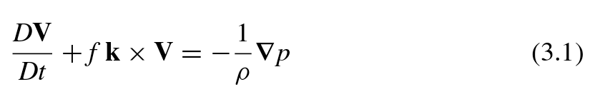
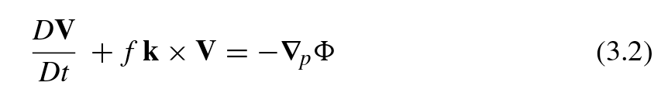

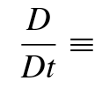
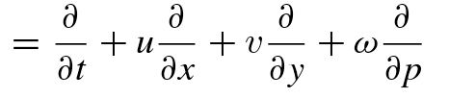


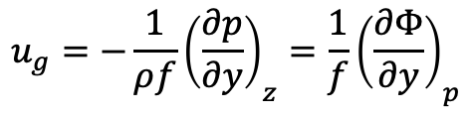
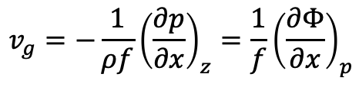
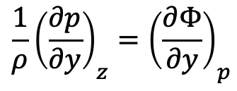
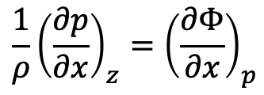
The Horizontal Momentum Equation
Z - coordinate
pressure gradient force
$$\frac{1}{ρ}{\left(\frac{∂p}{∂x}\right)}_{z}={\left(\frac{∂Φ}{∂x}\right)}_{p}$$
P - coordinate
$$\frac{1}{ρ}{\left(\frac{∂p}{∂y}\right)}_{z}={\left(\frac{∂Φ}{∂y}\right)}_{p}$$
Geostrophic Wind
$$v_{g}=−\frac{1}{ρf}{\left(\frac{∂p}{∂x}\right)}_{z}=\frac{1}{f}{\left(\frac{∂Φ}{∂x}\right)}_{p}$$
Vertical Velocity
$$u_{g}=−\frac{1}{ρf}{\left(\frac{∂p}{∂y}\right)}_{z}=\frac{1}{f}{\left(\frac{∂Φ}{∂y}\right)}_{p}$$

Slide 11
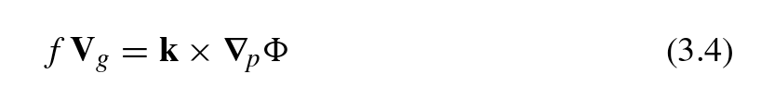

Advantage of isobaric coordinates
P - coordinate
Z - coordinate
Momentum Equation
Momentum Equation
Geostrophic Wind
Geostrophic Wind
Density does not appear in P-coordinate
A geostrophic wind is determined by geopotential gradient at any height
If f is regarded as a constant, the horizontal divergence of the geostrophic wind at constant pressure is zero

Slide 12
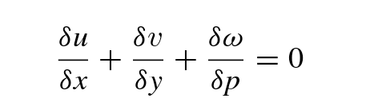

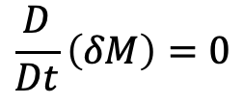
The Continuity Equation
$$δz→δp$$
Control volume
Control mass
Lagrangian expression
$$\frac{D}{Dt}\left(δM\right)=0$$

Slide 13
Advantage of isobaric coordinates
P - coordinate
Z - coordinate
Continuity Equation
Continuity Equation
Diagnostic form
Prognostic form
The continuity equation contains no reference to the density field
It does not involve time derivatives.
incompressible

Slide 14

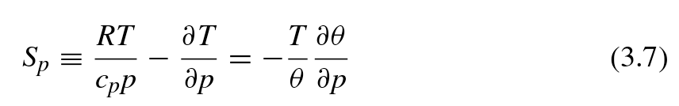
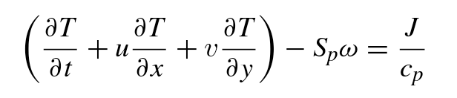

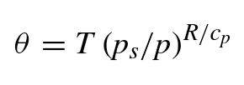




The Thermodynamic Equation
Expanding $\frac{DT}{Dt},$
$$Pα=RT$$
Static stability parameter
$$δp=−ρgδz$$

Slide 15

The Thermodynamic Equation
S_{p} is positive provided that the lapse rate is less than dry adiabatic.
Because density decreases approximately exponentially with height, S_{p} increases rapidly with height.
This strong height dependence of the stability measure S_{p} is a minor disadvantage of isobaric coordinates.

Slide 16
Equations in pressure coordinate
Advantage？
The Momentum Equation
The Continuity Equation
The Thermodynamic Energy Equation
Density does not appear
Time independent
Disadvantage？
Density in Thermodynamic

Slide 17
Equations in pressure coordinate
Why do we use pressure coordinates
On synoptic weather charts, the relationship between pressure (or geopotential height) and velocity are rather simple.
The flows are near steady state (i.e., time independent) and have no vertical component of velocity.
It is useful to rewrite the isobaric form of the horizontal momentum equation in a so-called natural coordinate system.

Slide 18









Nature Coordinates
better horizontal coordinates for describing balanced winds
$$\hat{y}$$
s
$$\hat{t}$$
$$\hat{n}$$
Tangent
$$\hat{n}$$
R
Normal
$$\hat{t}$$
$$\hat{t}$$
$$\hat{n}$$
R
$$\hat{k}$$
Cartesian coordinate system
$$\hat{x}$$
R: Radius of curvature following the parcel motion
R > 0, parcels turn left
(cyclonic flow)
R < 0, parcels turn right
(anti-cyclonic flow)
How to calculate R?

Slide 19
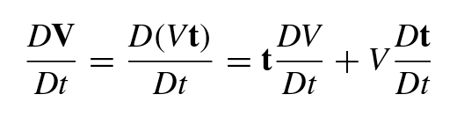
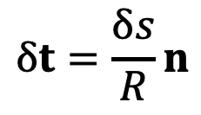

Nature Coordinates
Velocity
V (speed) is positive
Acceleration
The rate of change of t
When $δs→0, δt∥n$
Tangent
acceleration
Centripetal
acceleration
$$δt=\frac{δs}{R}n$$

Slide 20




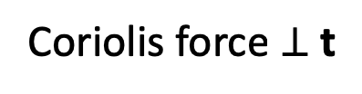


Nature Coordinates
The Momentum Equation in P-coordinate
Acceleration
Coriolis force
$$\hat{t}$$
$$\hat{n}$$
$$\hat{k}$$
Coriolis force $⊥$ t
$$\hat{t}$$
$$−fk×V=−fk×tV=−fVn$$
$$\hat{n}$$
Pressure gradient force

Slide 21




Balanced Flow
Balance in t direction
For motion parallel to the geopotential height contours
$\frac{∂Φ}{∂s}=0$, V is constant
Pressure gradient force
$$\frac{DV}{Dt}=−\frac{∂Φ}{∂s}$$
$$=0$$
Speed change
Balance in n direction
Pressure gradient force
If geopotential gradient normal to the motion is constant
R is constant
$$\frac{V^{2}}{R}+fV=−\frac{∂Φ}{∂n}$$
Path change
Pressure gradient
force
Centrifugal
force
Coriolis
force
4 cases for balanced flow
Geostrophic Flow: Coriolis = Pressure gradient
Inertial Flow: Centrifugal = Coriolis
Cyclostrophic Flow: Centrifugal = Pressure gradient
Gradient Wind: Centrifugal + Coriolis = Pressure gradient

Slide 22
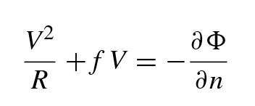
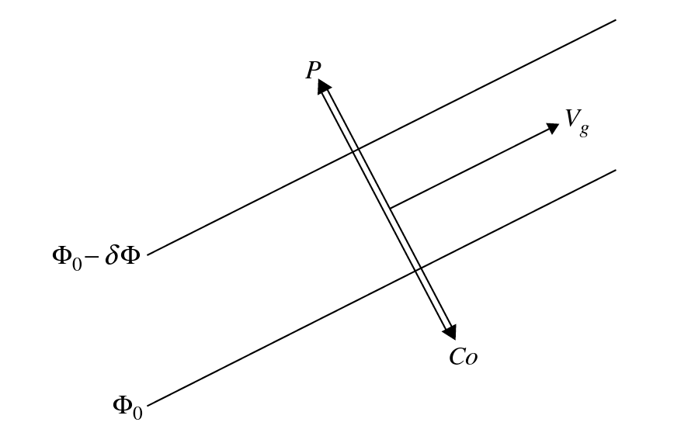

Geostrophic Flow
The magnitude of geostrophic wind is determined by the closeness of the contour lines
Coriolis = Pressure gradient

Slide 23
Geostrophic Flow
The exact geostrophic motion contour lines are
Straight lines
Parallel to latitude circle
Geostrophic wind is generally a good approximation to the actual wind in extra-tropical synoptic-scale disturbances
But in some case, this is not true

Slide 24

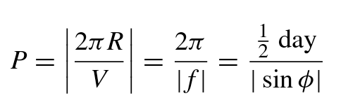
Inertial Flow (Oscillation)
When horizontal pressure gradient vanishes, balance between Coriolis force and centrifugal force
In NH
V>0, f>0
R<0
Anti-cyclonic circular paths
In SH
V>0, f<0
R>0

Slide 25
Anti-cyclonic circular paths
In NH
In SH
V
V
R<0
R<0
X
Centrifugal
Coriolis
Centrifugal
Coriolis
R>0
R>0
Centrifugal
X
Centrifugal
Coriolis
Coriolis
V
V

Slide 26
Inertial Flow (Oscillation)
In true inertial motion, all forces vanish and the motion maintains a uniform velocity.
In the atmosphere, motions are nearly always generated and maintained by pressure gradient forces; the conditions of uniform pressure required for pure inertial flow rarely exist.
In the oceans, however, currents are often generated by transient winds blowing across the surface, rather than by internal pressure gradients. As a result, significant amounts of energy occur in currents that oscillate with near inertial periods.

Slide 27
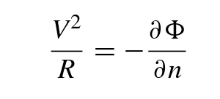
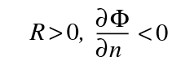
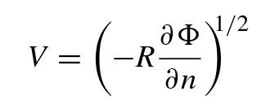


3.2.4 Cyclostrophic Flow
If the horizontal scale of the motion is small enough, balance between pressure gradient force and centrifugal force
Cyclonic low
Anti-cyclonic low
For a tornado
V = 30 m/s, R = 300m, f = 10⁻⁴ s⁻¹
Coriolis force can be neglected

Slide 28
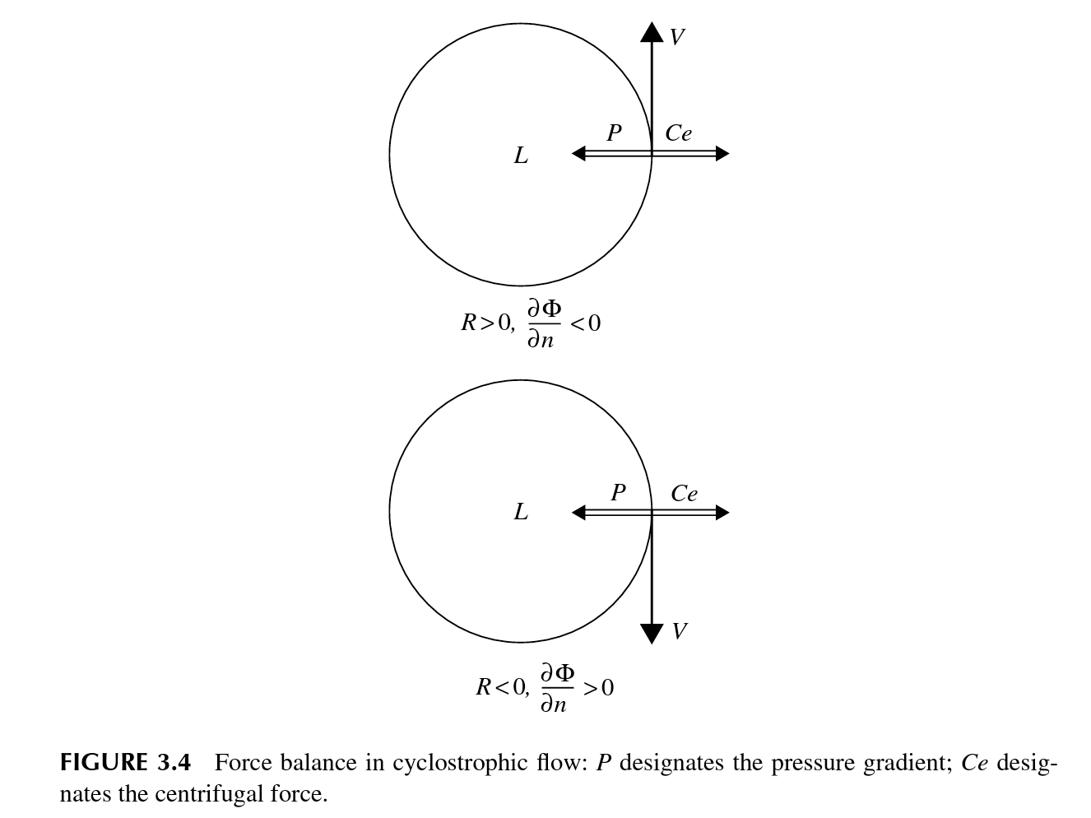
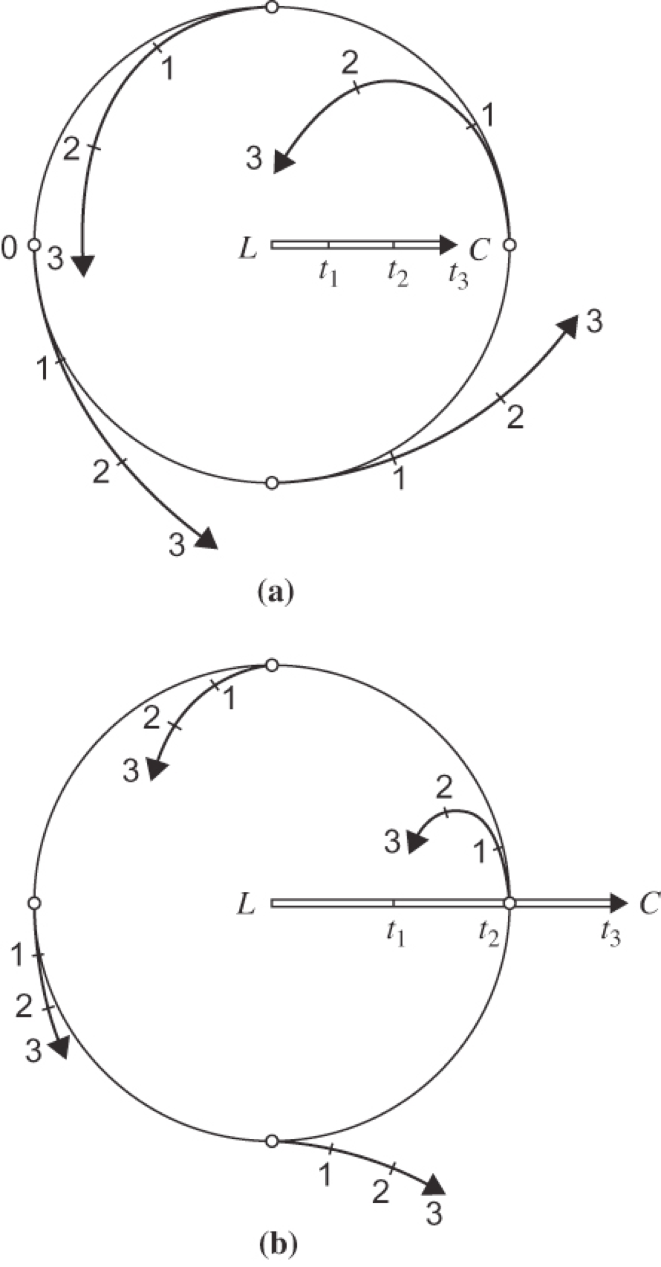
Majority of tornadoes in the NH are observed to rotate in a cyclonic sense. This is due to the fact that they are embedded in environments that favor cyclonic rotation
However, smaller-scale vortices, such as dust and water spouts, do not have a preferred direction of rotation.

