Slide 1
ATMO402 “Applied Atmospheric Dynamics”
Chapter 3
Elementary Applications of the Basic Equations
Pressure as a Vertical Coordinate
Basic Equations in Isobaric Coordinates
Natural Coordinates
Balanced Flow
Geostrophic Flow
Inertial Flow
Cyclostrophic Flow
The Gradient Wind Approximation
The Thermal Wind
Sen Zhao Email: zhaos@hawaii.edu
Notes:
Welcome back to Applied Atmospheric Dynamics Class.
Last week, we have learned about some of the Chapter 3.
We continue to talk about Chapter 3 in the Holton’s text book. On last lecture, we have learned
Why do we use the pressure as vertical coordinate?
What is advantage of the isobaric coordinates?
What is the natural coordinates, why we use it?
What is the balanced flow?
In this lecture, we continue to talk about the balanced flow learning how the three ways balance as the gradient wind.
And we also going to talk about relationship of geostrophic wind with temperature field, i.e., the thermal wind.
If you have any questions, please feel free to interrupt me.

Slide 2
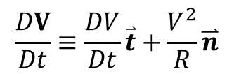
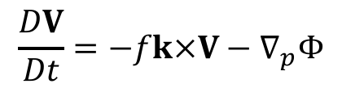
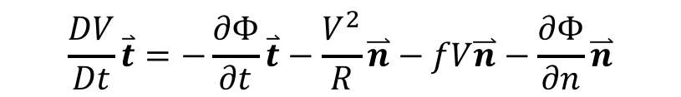





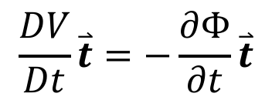

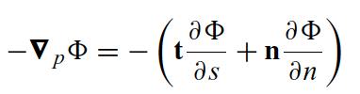

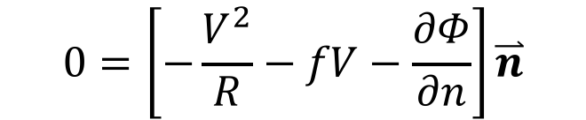
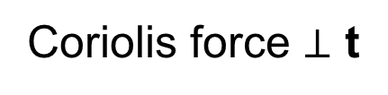
Horizontal momentum equation in Nature Coordinates
Acceleration
Acceleration
Forces
Tangent
Centripetal
Coriolis force
Coriolis force $⊥$ t
Pressure gradient force
Notes:
Typically, we use the latitude-longitude coordinate system to describing atmospheric motions.
However, for some classes of atmospheric flow it is more convenient to use the nature coordinates:
What is nature coordinates? It is a coordinate system in which one axis is everywhere tangent to the horizontal wind, represented by the units vector t, and a second axis is normal to and to the left of the wind, represented by the unit vector n.
the acceleration of the parcel in this coordinate system is made up of two components, the rate of change of the parcel speed along the path of the flow, and the centripetal acceleration of the parcel if it follows a curved path.
We begin with reviewing the horizontal equation in the nature coordinates
The acceleration following the motion is divided into tangent and centripetal parts.

Slide 3
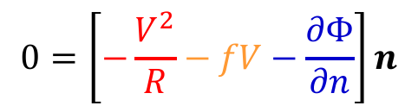



How to remember the direction of the forces
$$0=\left[−\frac{V^{2}}{R}−fV−\frac{∂Φ}{∂n}\right]n$$
Centrifugal force
$$−\frac{V^{2}}{R}n$$
An apparent force
Negative sign means it is always directed radially outwards from that axis
Coriolis force
$$−fVn$$
In the NH (f>0), directed to the right of the wind direction
In the SH (f<0), directed to the left of the wind direction
Pressure gradient force
$$−\frac{∂Φ}{∂n}n$$
Directed from high pressure (geopotential) to low pressure (geopotential)
Notes:
If we look at the forces in the right hand of equation more carefully
Centrifugal force is an apparent force, the negative sign means it it always directed out of center.
Coriolis force is due the rotation of earth. In the northern hemisphere, it is directed to the right of wind direction; In the southern hemisphere, it is directed to the left of the wind.
Pressure gradient force is directed from high pressure to low pressure.

Slide 4




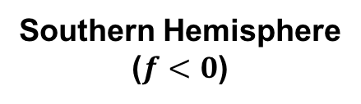

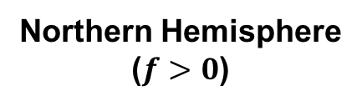


Cyclone/Anticyclone vs. Radius of curvature
Northern Hemisphere
($f>0$)
Southern Hemisphere
($f<0$)
$$V$$
$$V$$
$$n$$
$$n$$
Counterclockwise
Cyclonic flow
Anti-cyclonic flow
$$n$$
$$n$$
Clockwise
$$V$$
$$V$$
Anti-cyclonic flow
Cyclonic flow
Notes:
This figure shows the basic configuration of cyclone and anticyclone in the northern hemisphere and southern hemisphere.
For cyclonic flow in the northern hemisphere, the flow is counterclockwise with radius of curvature R is positive. But for southern hemisphere cyclonic flow is clockwise with R is negative.
For anticline flow in the northern hemisphere, the flow is ....

Slide 5



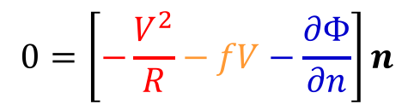

Inertial flow
$$0=\left[−\frac{V^{2}}{R}−fV−\frac{∂Φ}{∂n}\right]n$$
Northern Hemisphere
($f>0$)
Southern Hemisphere
($f<0$)
$$V$$
$$V$$
X
$$n$$
Coriolis
$$n$$
$$R>0$$
Centrifugal
Coriolis
Centrifugal
Counterclockwise
Cyclonic flow
Inertial flow can be only anti-cyclonic
Anti-cyclonic flow
X
Coriolis
$$R<0$$
Coriolis
$$n$$
$$n$$
Centrifugal
Centrifugal
Clockwise
$$V$$
$$V$$
Anti-cyclonic flow
Cyclonic flow
Notes:
When horizontal pressure gradient vanishes, balance between Coriolis force and centrifugal force

Slide 6

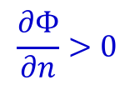

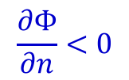

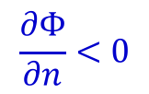

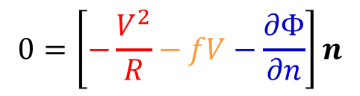


Cyclostrophic flow
$$0=\left[−\frac{V^{2}}{R}−fV−\frac{∂Φ}{∂n}\right]n$$
$$\frac{∂Φ}{∂n}<0$$
$$\frac{∂Φ}{∂n}>0$$
$$V$$
$$V$$
X
H
PGF
L
$$n$$
$$n$$
$$R>0$$
Centrifugal
PGF
Centrifugal
Counterclockwise
Cyclonic flow
Cyclonic flow
$$\frac{∂Φ}{∂n}>0$$
$$\frac{∂Φ}{∂n}<0$$
X
H
PGF
L
$$R<0$$
$$n$$
Clockwise
$$n$$
Centrifugal
PGF
Centrifugal
Anti-cyclonic flow
$$V$$
Anti-cyclonic flow
$$V$$

Slide 7
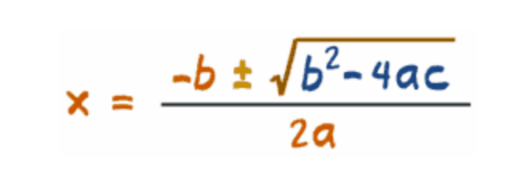
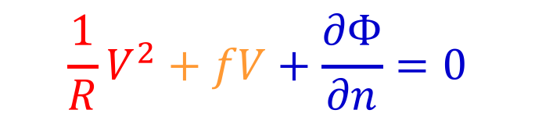
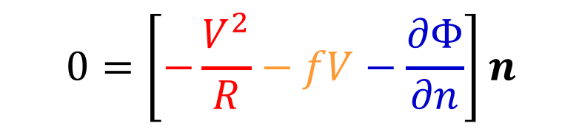

Gradient wind
A three-way balance among the Coriolis, centrifugal, and pressure gradient forces.
$$0=\left[−\frac{V^{2}}{R}−fV−\frac{∂Φ}{∂n}\right]n$$
$$\frac{1}{R}V^{2}+fV+\frac{∂Φ}{∂n}=0$$
Rewrite as
Looks like quadratic
$$ax^{2}+bx+c=0$$
Roots of the quadratic formula

Slide 8
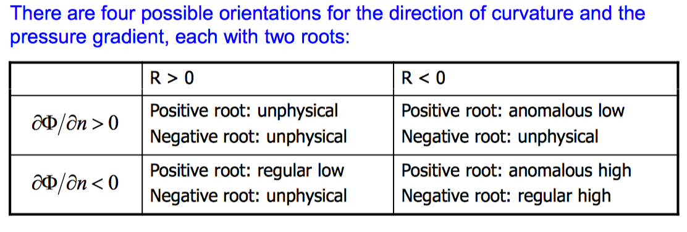
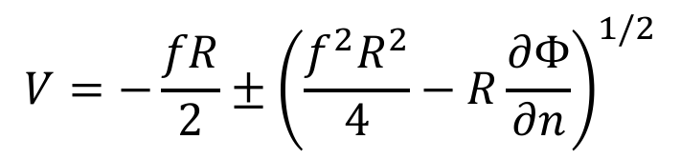
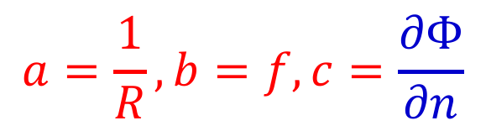
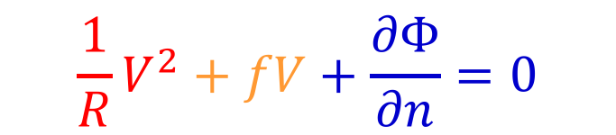
Solution for gradient wind
$$\frac{1}{R}V^{2}+fV+\frac{∂Φ}{∂n}=0$$
$$a=\frac{1}{R},b=f,c=\frac{∂Φ}{∂n}$$
Substituting with
The solutions in nature coordinates:
$$V=−\frac{fR}{2}±{\left(\frac{f^{2}R^{2}}{4}−R\frac{∂Φ}{∂n}\right)}^{1/2}$$

Slide 9

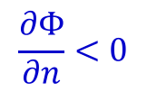



Gradient Wind Approximation
$$0=\left[−\frac{V^{2}}{R}−fV−\frac{∂Φ}{∂n}\right]n$$
Northern Hemisphere
($f>0$)
$$\frac{∂Φ}{∂n}>0$$
$$V$$
$$\frac{∂Φ}{∂n}<0$$
$$V$$
X
H
Coriolis
L
Coriolis
$$n$$
PGF
$$n$$
$$R>0$$
PGF
Centrifugal
Centrifugal
Counterclockwise
Cyclonic low
(regular)
Cyclonic high
$$\frac{∂Φ}{∂n}>0$$
$$\frac{∂Φ}{∂n}<0$$
H
PGF
L
Coriolis
$$R<0$$
$$n$$
Clockwise
$$n$$
Coriolis
Centrifugal
PGF
Centrifugal
$$V$$
$$V$$
Anti-cyclonic low (anomalous)
Anti-cyclonic high

Slide 10
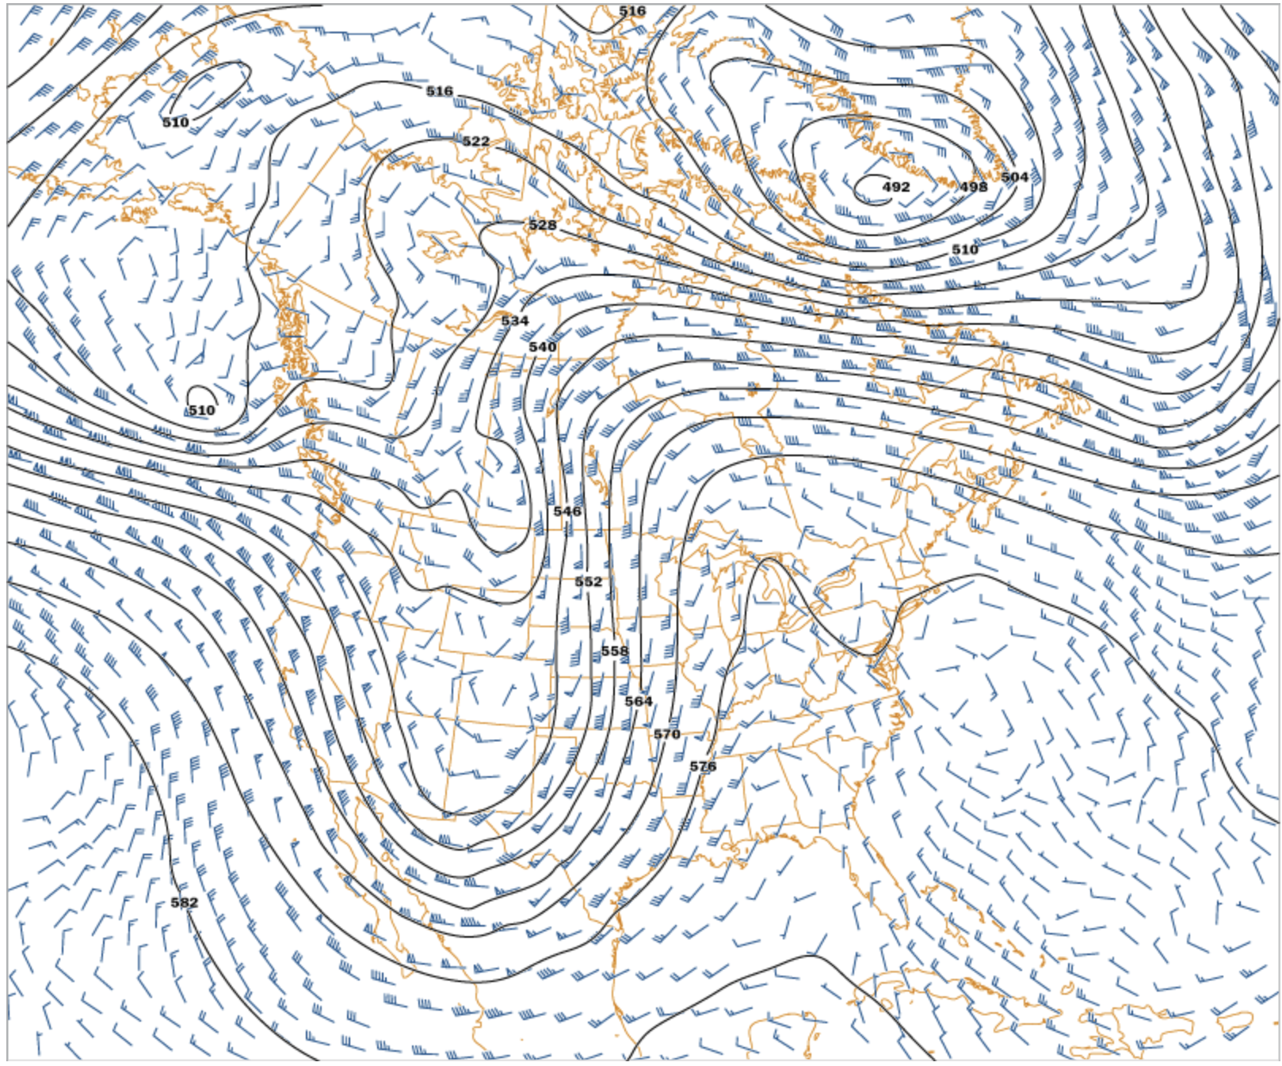
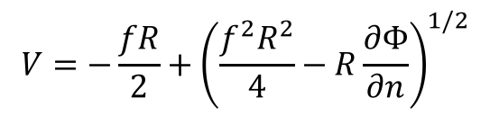

Cyclonic low in the NH
Northern Hemisphere
($f>0$)
500 mb
$\frac{∂Φ}{∂n}<0$, $R>0$
$$V$$
L
Coriolis
$$n$$
PGF
Centrifugal
Cyclonic low
(regular)
L
$$V=−\frac{fR}{2}+{\left(\frac{f^{2}R^{2}}{4}−R\frac{∂Φ}{∂n}\right)}^{1/2}$$

Slide 11
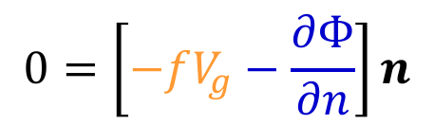


Baric Flow
Baric flow: the Coriolis and pressure gradient forces are oppositely directed.
However, anomalous low is anti-baric flow.
$$\frac{∂Φ}{∂n}>0$$
Recalling the geostrophic approximation
$$R<0$$
$$0=\left[−fV_{g}−\frac{∂Φ}{∂n}\right]n$$
X
L
Coriolis
$$n$$
the geostrophic wind V_{g} is negative and is clearly not a useful approximation to the actual speed
PGF
Centrifugal
$$V$$
Anti-cyclonic low (anomalous)
Northern Hemisphere
($f>0$)

Slide 12
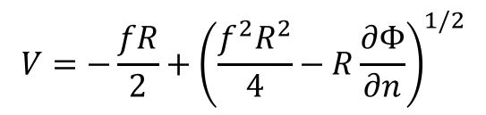


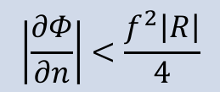
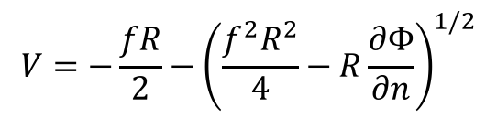
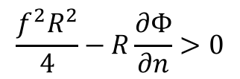
Anticyclonic high
$$0=\left[−\frac{V^{2}}{R}−fV−\frac{∂Φ}{∂n}\right]n$$
Northern Hemisphere
($f>0$)
$\frac{∂Φ}{∂n}<0$, $R<0$
$$V=−\frac{fR}{2}−{\left(\frac{f^{2}R^{2}}{4}−R\frac{∂Φ}{∂n}\right)}^{1/2}$$
$$V=−\frac{fR}{2}+{\left(\frac{f^{2}R^{2}}{4}−R\frac{∂Φ}{∂n}\right)}^{1/2}$$
H
PGF
H
PGF
$$n$$
$$n$$
Coriolis
Centrifugal
Coriolis
Centrifugal
$$V$$
$$V$$
Regular High
Anomalous High
For both regular and anomalous highs, it is required
$$\frac{f^{2}R^{2}}{4}−R\frac{∂Φ}{∂n}>0$$
$$\left|\frac{∂Φ}{∂n}\right|<\frac{f^{2}\left|R\right|}{4}$$
As |R| → 0, pressure gradient approach zero. The pressure field near the center of a high is always flat, the wind is usually gentle.

Slide 13
Anticyclonic high

Slide 14
Why we call “regular” or “anomalous” ?
The absolute angular momentum about the axis of rotation for the circularly symmetric motions is given by VR + f R²/2.
 | NH | SH
absolute angular momentum > 0 | regular | anomalous
absolute angular momentum < 0 | anomalous | regular
Regular gradient wind balances have positive absolute angular momentum in the NH.
Anomalous cases have negative absolute angular momentum

Slide 15
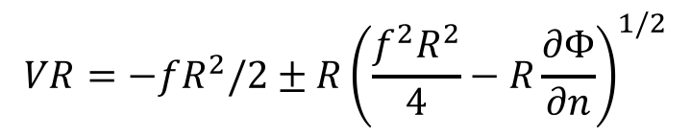
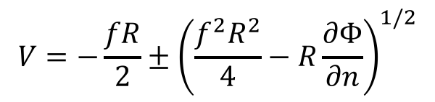
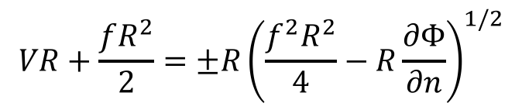
Absolute angular momentum of gradient wind
$$V=−\frac{fR}{2}±{\left(\frac{f^{2}R^{2}}{4}−R\frac{∂Φ}{∂n}\right)}^{1/2}$$
Gradient wind
$$VR=−fR^{2}/2±R{\left(\frac{f^{2}R^{2}}{4}−R\frac{∂Φ}{∂n}\right)}^{1/2}$$
Times R both sides
$$VR+\frac{fR^{2}}{2}=±R{\left(\frac{f^{2}R^{2}}{4}−R\frac{∂Φ}{∂n}\right)}^{1/2}$$
Absolute angular momentum of gradient wind
 | NH | SH
absolute angular momentum > 0 | Regular: R>0, select + root (C) R<0, select – root (A) | anomalous
absolute angular momentum < 0 | anomalous | Regular: R>0, select – root (A) R<0, select + root (C)

Slide 16
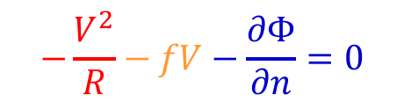

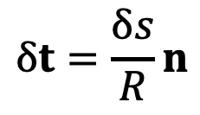

Gradient wind vs. Geostrophic wind (1)
    Directions are the same, is parallel to the isobars, low pressure in its left in NH.
$$−\frac{V^{2}}{R}−fV−\frac{∂Φ}{∂n}=0$$
$$−\frac{V^{2}}{R}−fV+fV_{g}=0$$
$$\frac{V_{g}}{V}=1+\frac{V}{fR}=1+R_{o}$$
$${fV}_{g}=−\frac{∂Φ}{∂n}$$
For normal cyclonic flow ( f R > 0), V_{g} > V , whereas for anticyclonic flow ( f R < 0), V_{g} < V .
Therefore, the geostrophic wind is an overestimate in a region of cyclonic curvature and an underestimate in a region of anticyclonic curvature.

Slide 17

Gradient wind vs. Geostrophic wind (2)
$$\frac{V_{g}}{V}=1+\frac{V}{fR}=1+R_{o}$$
the magnitude of V /( f R ) is just the Rossby number.
Small Ro
For mid-latitude synoptic systems, Ro ~ 0.1, the difference between gradient and geostrophic wind speeds generally < 10 to 20%.
Large Ro
f is small region, for the tropical disturbances, the Ro ~ 1-10, and the gradient wind formula must be applied rather than the geostrophic wind.
R is small, such as tornadoes, Ro ~ 10³, cyclostrophic flow is dominated.
Highly curved wind.

Slide 18
The thermal wind
Holton’s Text Book
“The geostrophic wind must have vertical shear in the presence of a horizontal temperature gradient, as can be shown easily from simple physical considerations based on hydrostatic equilibrium.”
Notes:
Your textbook tell us in the very beginning of this section :
I think I have to object to the word easily, but that what we will be showing here.
We gone be learning about how …
The way think about it is the other way around is there is horizontal temperature gradient, it must have vertical shear of the geostrophic wind.

Slide 19
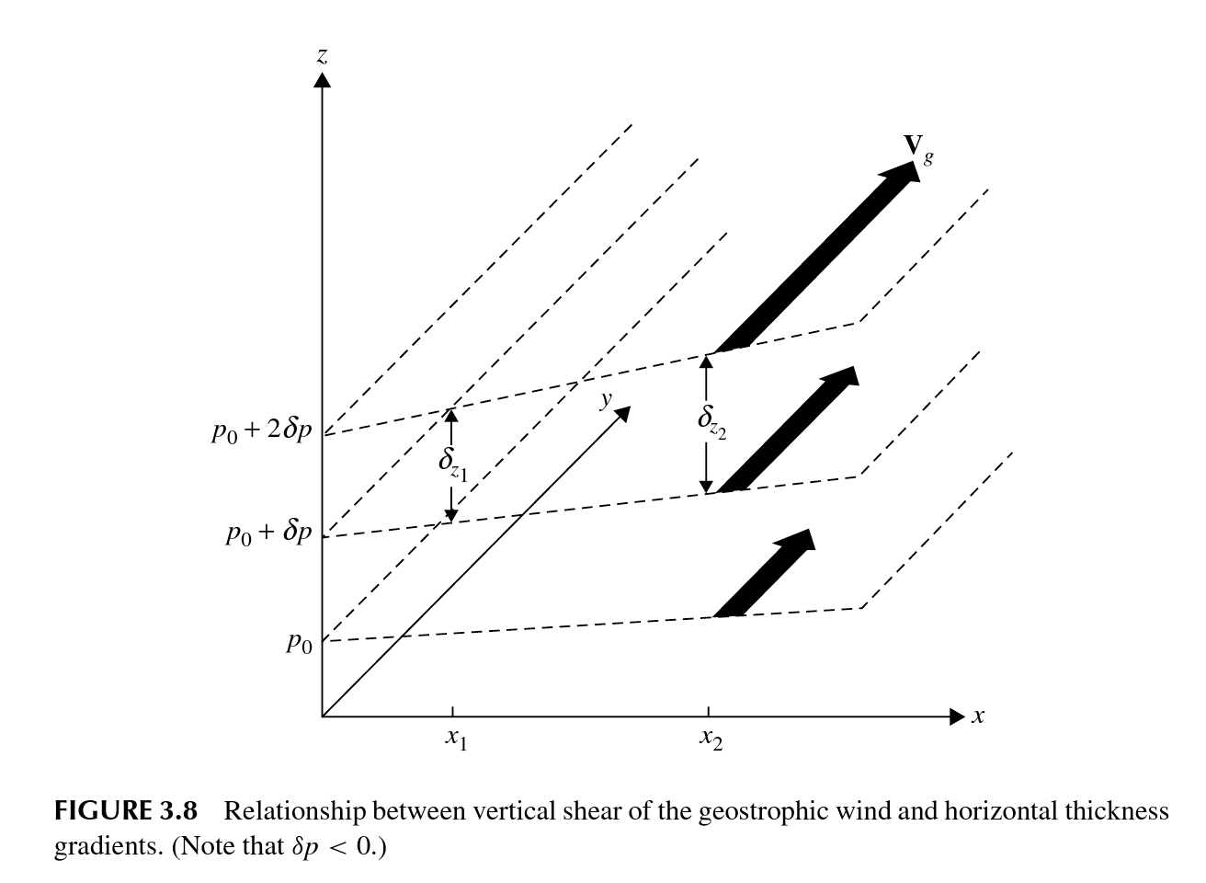
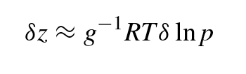
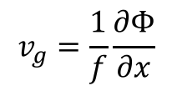

A illustration of thermal wind
  The thickness between the pressure surface is larger at higher temperature place than that at lower temperature place
Thickness between two isobars is proportional to the mean temperature in the layer.
  The horizontal gradient of geopotential height becomes larger in upper level than over lower level
$$\frac{∂Φ}{∂x} inreases with height$$
  Geostrophic wind must be greater over the upper level than that of lower level.
T_{x1} < T_{x2}
$$v_{g}=\frac{1}{f}\frac{∂Φ}{∂x}$$
Notes:
This figure shows the relationship for thickness delta z, geostrophic wind, and temperature.
The air in the column at x2, the mean temperature is warmer (less dense), must have occupy a greater thickness for a given pressure drop.

Slide 20


The geostrophic wind must have vertical shear in the presence of a horizontal temperature gradient
is saying that
Change in the geostrophic wind with respect to height, i.e.,
depends on horizontal temperature gradient
$$\frac{∂V_{g}}{∂p}$$
$$∇_{p}T$$
How?

Slide 21
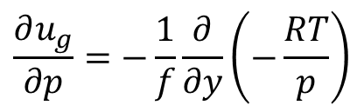
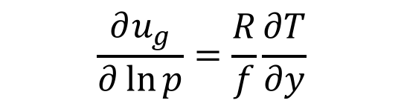
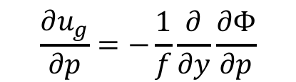
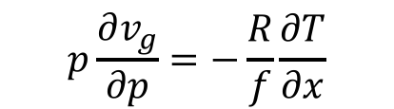
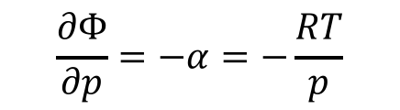
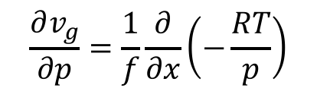

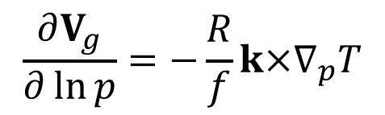




Deriving the thermal wind relationship
The thermal wind relationship can be derived by
The geostrophic approximation
Differentiating with respect to pressure:
$$u_{g}=−\frac{1}{f}\frac{∂Φ}{∂y} ,v_{g}=\frac{1}{f}\frac{∂Φ}{∂x}$$
$$\frac{∂u_{g}}{∂p}=−\frac{1}{f}\frac{∂}{∂y}\frac{∂Φ}{∂p}$$
$$\frac{∂v_{g}}{∂p}=\frac{1}{f}\frac{∂}{∂x}\frac{∂Φ}{∂p}$$
$$V_{g}=\frac{1}{f}k×∇_{p}Φ$$
$$\frac{∂u_{g}}{∂p}=−\frac{1}{f}\frac{∂}{∂y}\left(−\frac{RT}{p}\right)$$
$$\frac{∂v_{g}}{∂p}=\frac{1}{f}\frac{∂}{∂x}\left(−\frac{RT}{p}\right)$$
The hydrostatic approximation
$$p\frac{∂u_{g}}{∂p}=\frac{R}{f}\frac{∂T}{∂y}$$
$$p\frac{∂v_{g}}{∂p}=−\frac{R}{f}\frac{∂T}{∂x}$$
$$\frac{∂Φ}{∂p}=−α=−\frac{RT}{p}$$
The thermal wind equation
$$\frac{∂u_{g}}{∂\ln{p}}=\frac{R}{f}\frac{∂T}{∂y}$$
$$\frac{∂v_{g}}{∂\ln{p}}=−\frac{R}{f}\frac{∂T}{∂x}$$
$$\frac{∂V_{g}}{∂\ln{p}}=−\frac{R}{f}k×∇_{p}T$$
Notes:
Make some substitutions

Slide 22





The thermal wind vector $V_{T}$
A relationship for the vertical wind shear (i.e., the rate of change of the geostrophic wind with respect to ln p).
The vector difference between geostrophic winds at two levels.
$$\frac{∂V_{g}}{∂\ln{p}}=−\frac{R}{f}k×∇_{p}T$$
Integrating thermal wind equation from pressure level p₀ to level p₁ to get
$$V_{T}≡V_{g}\left(p_{1}\right)−V_{g}\left(p_{0}\right)=−\frac{R}{f}\int_{p_{0}}^{p_{1}}{k×∇_{p}Td\ln{p}}$$
Letting $\left\langle T\right\rangle$ denote the mean temperature in the layer between pressure level p₀ and level p_{1.}
$$V_{T}=−\frac{R}{f}k×∇_{p}\left\langle T\right\rangle \ln{\frac{p_{0}}{p_{1}}}$$
$$note −ln{\frac{p_{1}}{p_{0}}}=ln{\frac{p_{0}}{p_{1}}>0}$$

Slide 23









The thermal wind vector $V_{T}$
$$u_{T}=−\frac{R}{f}\frac{∂\left\langle T\right\rangle }{∂y}\ln{\frac{p_{0}}{p_{1}}}$$
$$V_{T}=−\frac{R}{f}k×∇_{p}\left\langle T\right\rangle \ln{\frac{p_{0}}{p_{1}}}$$
$$v_{T}=\frac{R}{f}\frac{∂\left\langle T\right\rangle }{∂x}\ln{\frac{p_{0}}{p_{1}}}$$
$$T−δT$$
Cold
$V_{T}$ parallel to the isotherms with the cold air at the left and warm air at the right of the thermal wind direction in NH
$${−∇}_{p}T$$
$$V_{T}$$
$$T$$
Warm

Slide 24




The thermal wind vector $V_{T}$
Finding <T> itself is kind of a mess
But thickness is not a problem at all!
The thickness of the layer from $p_{0}$ to $p_{1}$ is just $Φ_{1}−Φ_{0}$
So, the thermal wind in terms of horizontal gradient of thickness
$$u_{T}=−\frac{1}{f}\frac{∂}{∂y}\left(Φ_{1}−Φ_{0}\right)$$
$$V_{T}≡V_{g}\left(p_{1}\right)−V_{g}\left(p_{0}\right)$$
$=\frac{1}{f}k×∇_{p}\left(Φ_{1}−Φ_{0}\right)$
$$v_{T}=\frac{1}{f}\frac{∂}{∂x}\left(Φ_{1}−Φ_{0}\right)$$

Slide 25




Thickness vs. Mean temperature
The hydrostatic approximation
$$\frac{∂Φ}{∂p}=−α=−\frac{RT}{p}$$
$Φ_{1}−Φ_{0}=gZ_{T}=−R\left\langle T\right\rangle$ $\ln{\frac{p_{1}}{p_{0}}}$
$=R\left\langle T\right\rangle$ $\ln{\frac{p_{0}}{p_{1}}}$
The thickness is proportional to the mean temperature in the layer. Hence, lines of equal $Z_{T}$ (isolines of thickness) are equivalent to the isotherms of mean temperature in the layer.

Slide 26

Thermal wind and temperature advection
Cold advection, backing with height
(wind turns counterclockwise)
Geostrophic wind on Level 1
Geostrophic wind on Level 0
Thermal wind: Change of geostrophic wind between Level 0 and 1

Slide 27
Warm advection, veering with height
(wind turns clockwise)
Thermal wind: Change of geostrophic wind between Level 0 and 1
Geostrophic wind on Level 1
Geostrophic wind on Level 0

Slide 28


Slide 29
Vg @ 1000 hPa
Vg @ 500 hPa
V_{T}

Slide 30
Thermal Wind
Thermal wind blows parallel to the isotherms (thickness contours) with the cold air at the left and warm air at the right of the wind direction in NH.
Thermal wind strength is proportional to mean temperature gradient.
A geostrophic wind turning counterclockwise with height is associated with cold-air advection.
Clockwise turning (veering) of the geostrophic wind with height implies warm advection.
Implications
The horizontal temperature advection can be estimated from the sounding of wind at a given location.
The geostrophic wind at any level can be calculated from the mean temperature.

Slide 31
Questions?

Slide 32
Gradient Wind in the SH
$$0=\left[−\frac{V^{2}}{R}−fV−\frac{∂Φ}{∂n}\right]n$$
Southern Hemisphere
($f<0$)
$$\frac{∂Φ}{∂n}>0$$
$$V$$
$$\frac{∂Φ}{∂n}<0$$
$$V$$
H
L
$$n$$
$$n$$
$$R>0$$
Counterclockwise
$$\frac{∂Φ}{∂n}>0$$
$$\frac{∂Φ}{∂n}<0$$
H
L
$$R<0$$
$$n$$
Clockwise
$$n$$
$$V$$
$$V$$

Slide 33


Temperature Gradient and Geostrophic Wind
Text Book Example
For example, if the geostrophic wind at 850 hPa is known and the mean horizontal temperature gradient in the layer 850 to 500 hPa is also known, the thermal wind equation can be applied to obtain the geostrophic wind at 500 hPa.
$$V_{g}\left(500 hPa\right)=V_{g}\left(850 hPa\right)+V_{T}$$
$$=V_{g}\left(850 hPa\right)−\frac{R}{f}k×∇_{p}\left\langle T\right\rangle \ln{\frac{850}{500}}$$

Slide 34

horizontal temperature advection?

Slide 35


Slide 36



Where is jet core?
$$u_{T}=−\frac{R}{f}\frac{∂\left\langle T\right\rangle }{∂y}\ln{\frac{p_{0}}{p_{1}}}$$
$$\frac{∂\left\langle T\right\rangle }{∂y}$$
-
+
-
−
$$u_{T}$$
-
+
+
−
-
−
-
+
+
+
f>0
y direction
f<0

Slide 37

Where is jet core?
$$u_{T}=−\frac{R}{f}\frac{∂\left\langle T\right\rangle }{∂y}\ln{\frac{p_{0}}{p_{1}}}$$
$$\frac{∂\left\langle T\right\rangle }{∂y}$$
-
+
-
−
$$u_{T}$$
-
+
+
−
-
−
-
+
+
+
f>0
y direction
f<0

Slide 38

Ocean surface currents

Slide 39
Given a geopotential height field, how to estimate the geostrophic wind?

Slide 40
In p coordinate, for p=1000 hPa
Vg > actual wind
~ actual wind

